Slide 1
Welcome to Marketing Management
Dr. Cecilia Ruvalcaba
BUSI 107 Week 10, Day 2

Slide 2
Delivering Value Through Marketing Channels

Slide 3
Channel structure for consumer products
Direct
Channel
Retailer
Channel
Wholesaler
Channel
Agent/Broker
Channel
Producer
Producer
Producer
Producer
Agents or Brokers
Wholesalers
Wholesalers
Retailers
Retailers
Retailers
Consumers
Consumers
Consumers
Consumers
A set of interdependent organizations that ease the transfer of ownership as products move from producer to business user or consumer.

Slide 4
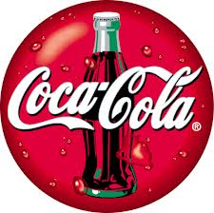
Marketing Channels
Functions:
Transactional: Buying, Selling, Risk Taking
Logistical: Assorting, Storing, Sorting, Transporting
Facilitating: Financing, Grading, Information & Research
Objectives:
Marketing channels exist to create utility for customers
Place utility
Time utility
Form utility
Information utility
“Within an arm’s reach of desire”
Who are the target customers, and where are they located?
What are their information requirements?
What are their preferences for service?
How sensitive are they to price?

Slide 5

Coordination of Marketing Activities
Reliant on an efficient supply chain
Fulfill delivery promises
Meet customer expectations

Slide 6
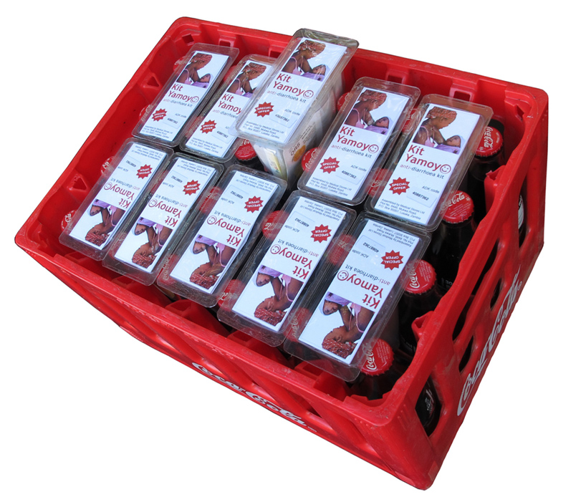
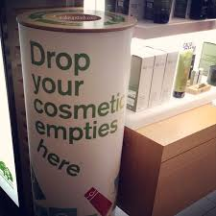



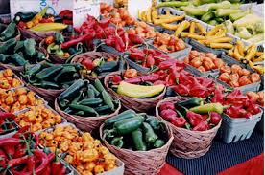

Socially Responsible Distribution
Notes:
TEDxBerlin - Simon Berry - "Colalife" https://www.youtube.com/watch?v=PWJUhKF7xik
http://www.colalife.org/
https://www.youtube.com/watch?v=dzE16c1fIns

Slide 7

Or not…
Notes:
http://www.theguardian.com/sustainable-business/sustainable-fashion-blog/2014/nov/03/feminist-t-shirt-scandal-exposes-entire-system-exploitation-elle-whistles-fawcett-society

Slide 8


Take Away for Today
Planning for Collaboration
The best channel is a well-planned collaboration
What is the value?
Matching your utility with your customers
Social Responsibility at every angle

Slide 9

Next Class
Chapter 16: Supply Chain and Channel Management
Chapter 17: Retailing and Omnichannel Marketing

